Slide 1
Fire hazard and plant invasions, the cases of Hakea sericea and Acacia dealbata in Portugal
Joaquim S. Silva, Mauro Nereu, Luis Queirós, Ernesto Deus, Paulo Fernandes
ESAC-IPC, CFE-UC, CEABN-UL, CITAB-UTAD

Slide 2
The problem
Portugal is an invasion-prone country, given its mild climate, the current fire regime and the introduction of many fire-adapted alien plant species
These conditions are leading to a widespread expansion of totally novel ecosystems, still poorly studied and understood
This is the case of areas dominated by two problematic species brought from Australia:
Acacia dealbata – Silver Wattle
Hakea sericea – Silky hakea

Slide 3
Acacia dealbata (tree up to 30 m height)
As many other Fabaceae, it develops a soil seed bank
The hard-coated seeds may be stored in the soil for decades
Fire triggers seed germination
It resprouts vigorously after fire
Seed pods can be dispersed at long distances

Slide 4
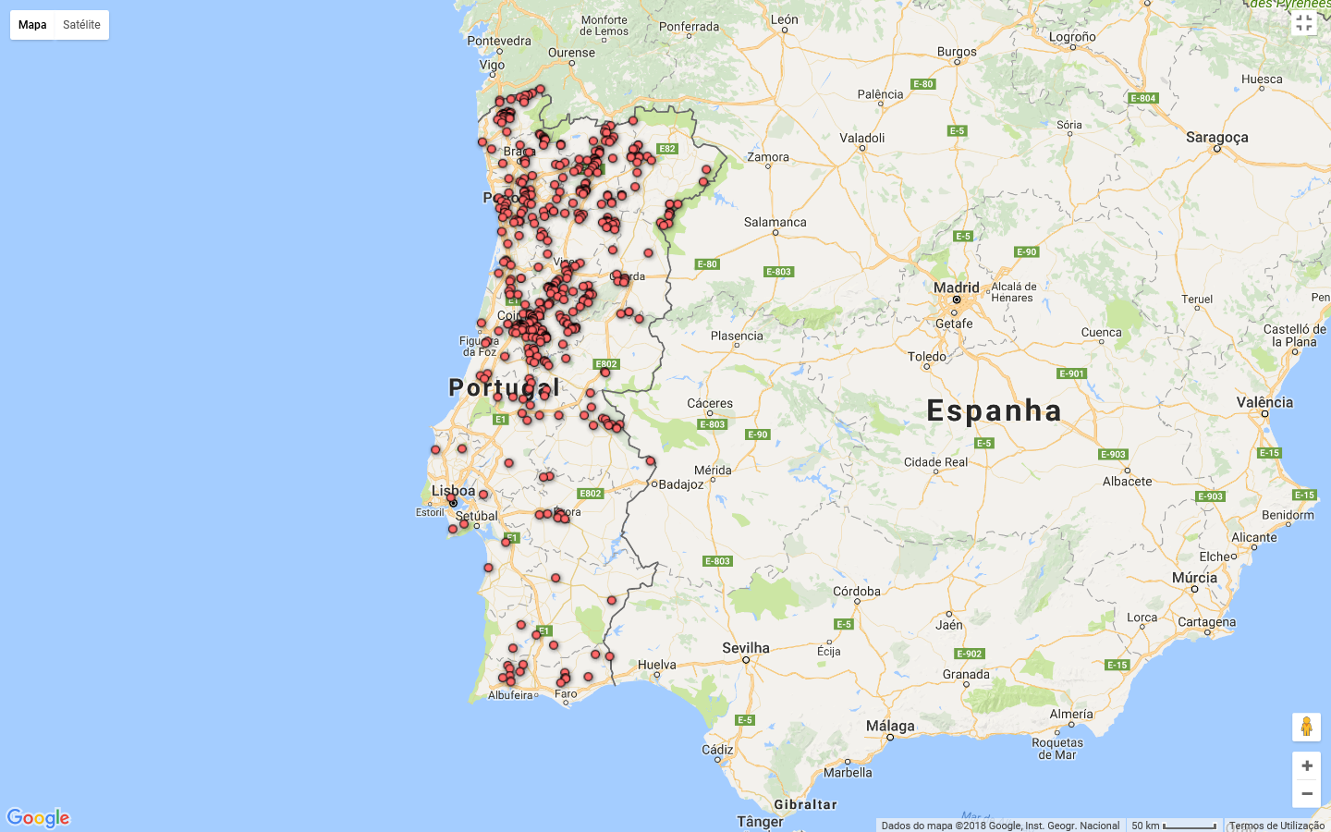
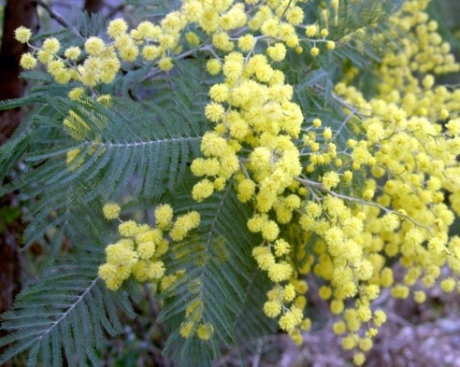
www.invasoras.uc.pt
Silver wattle – Acacia dealbata

Slide 5
Hakea sericea (tall shrub up to 4-5 m height)
It is an obligate seeder
It develops a canopy seed bank
Woody fruits open after fire and may disperse the seeds at considerable distances (>100 m), therefore expanding the invaded area

Slide 6
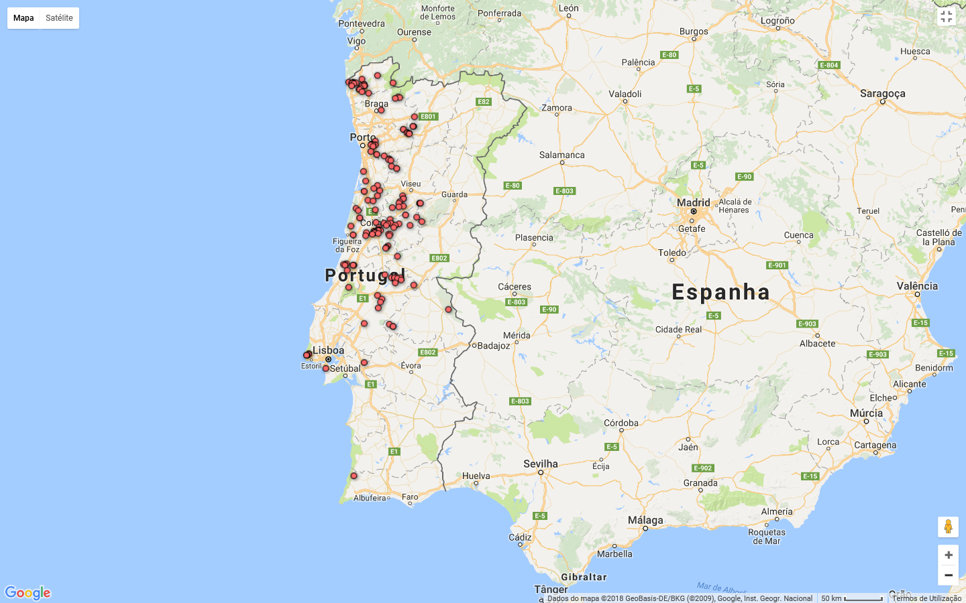
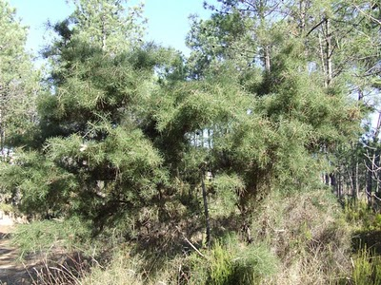
www.invasoras.uc.pt
Silky hakea or needlebrush – Hakea sericea

Slide 7
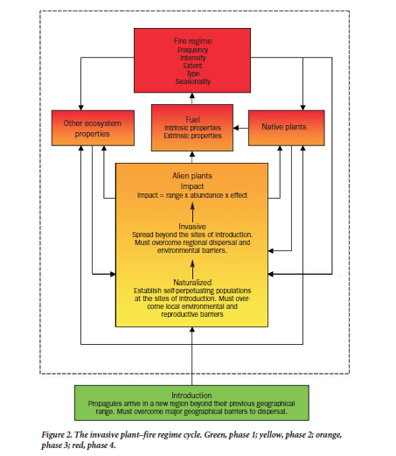
Fire and fire-adapted alien plants species may be connected through a fire cycle
Brooks et al. 2004

Slide 8
Therefore, the use of fire as a fuel management tool may aggravate the problem of plant invasions
Yet, proper management through an informed use of fire, may:
At least, minimize the risk of expanding the invasive plants, using an apropriate prescription;
If properly used, it may even contribute to locally eliminate the invasive plant species.

Slide 9
However
Currently we don’t know how to set a prescription envisaging the achievment of such goals;
The existing guides on prescribed burning for portuguese conditions:
Have the sole goal of managing fuels for fire hazard mitigation
Did not consider the risk of plant invasions

Slide 11
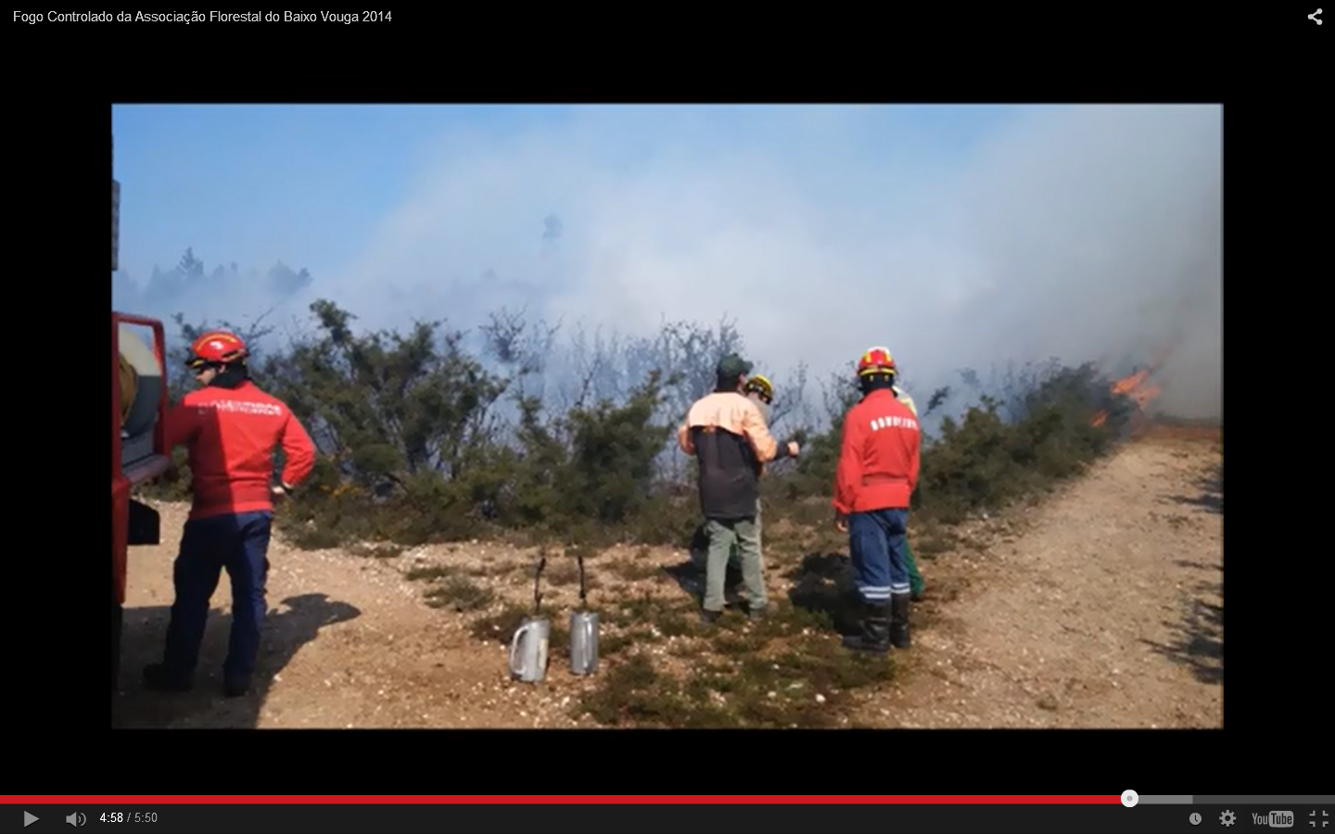
Burn, March 2014

Slide 12
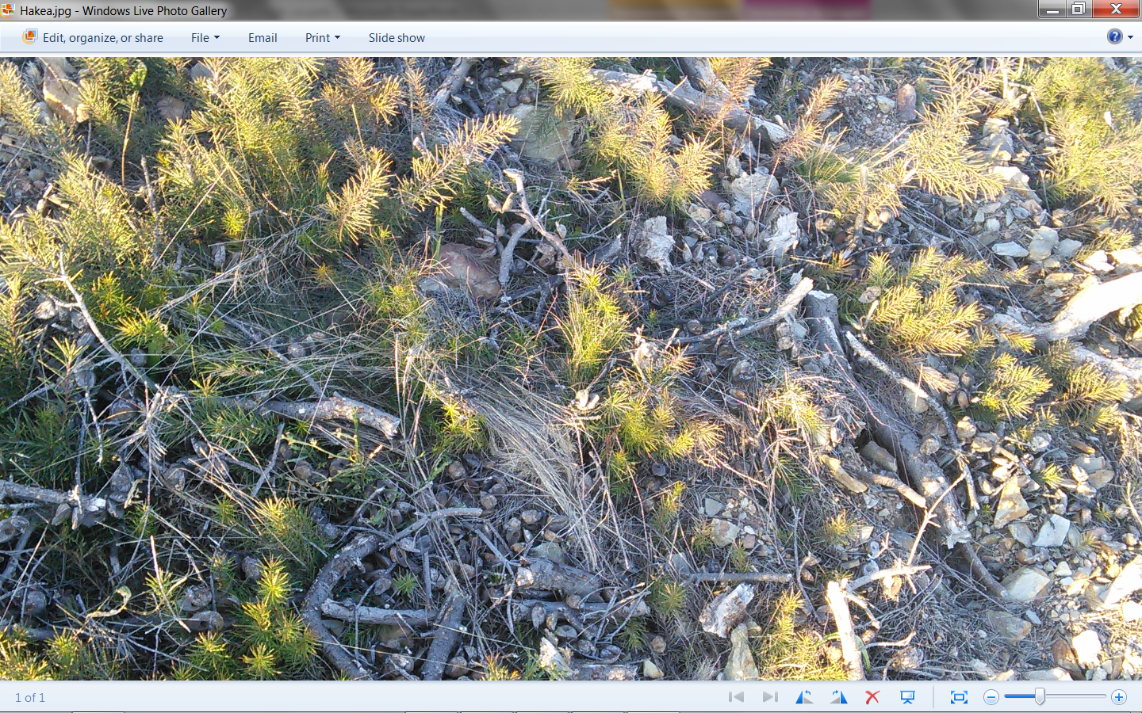
12
March 2016

Slide 13
April 2018

Slide 14
The Aliens & Flames project comprises several tasks dedicated to:
Characterize the fuel properties associated with the two alien plant species
Apply diferent types of slash and burn treatments in experimental plots
Monitor the effects of these treatments on the seed bank and on the individual plants
Produce a guide of best practices to deal with these fire adapted plant species

Slide 15
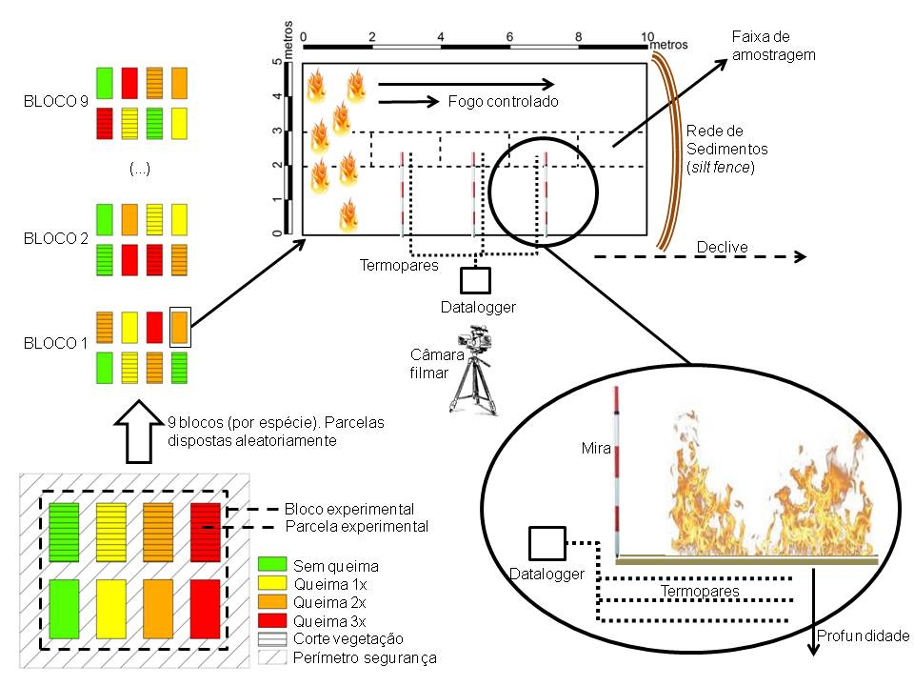
Weather station

Slide 16
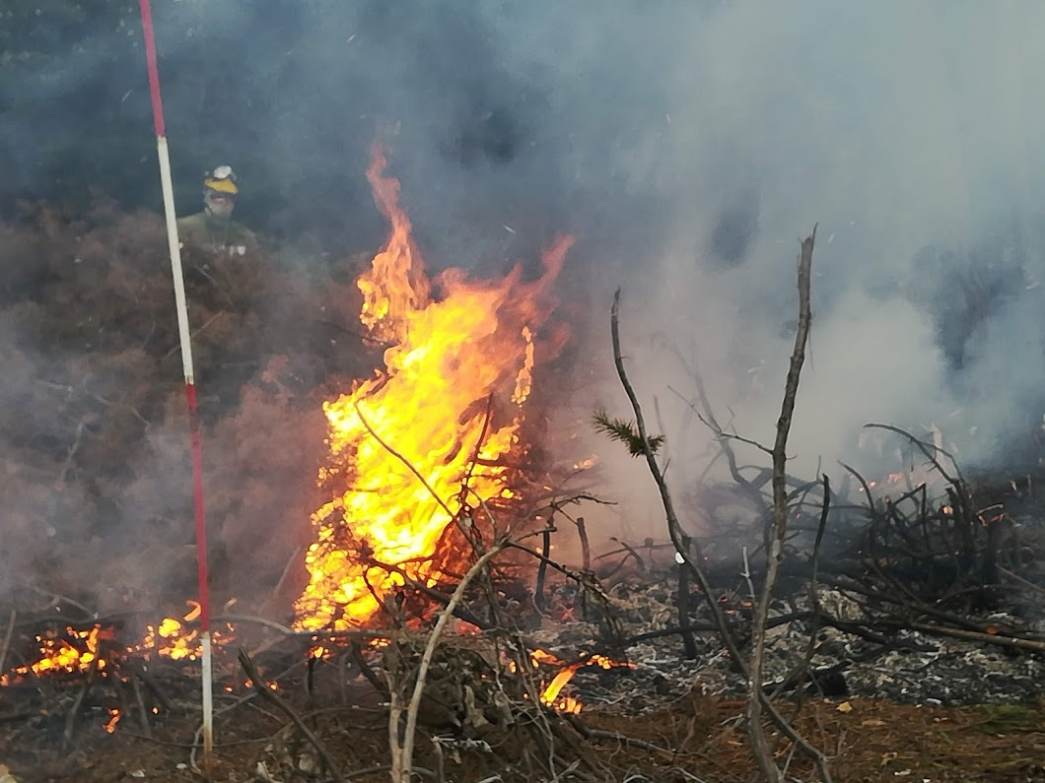
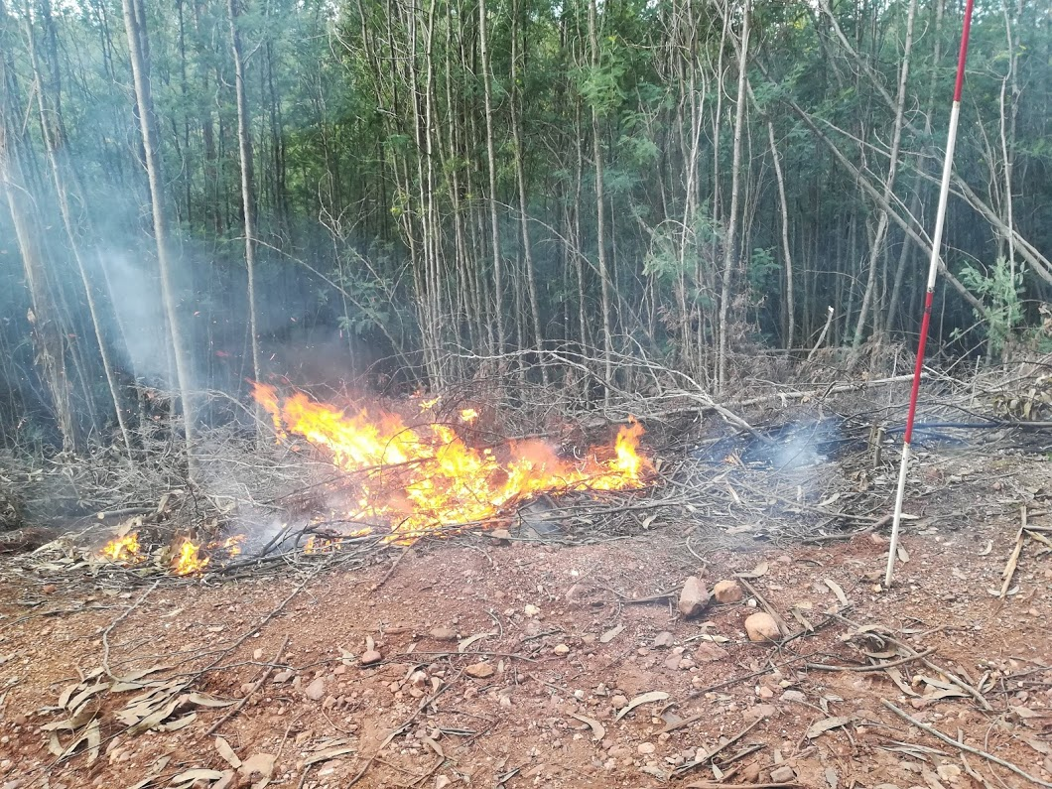
Hakea sericea
Acacia dealbata

Slide 17
Fuel characteristics and potential fire behavior

Slide 18
**
0.12
Litter Fuel Bed Depth (m)
0.08
*
0.04
Acacia dealbata
Hakea sericea
Species

Slide 19
**
60
40
1H Fuel Load (ton/ha)
*
20
0
Acacia dealbata
Hakea sericea
Species

Slide 20
 | A. dealbata | Broadleaf forest | H. sericea | Tall shrubland
1-h load (ton/ha) | 7.59±1.25* | 2.67 | 17.85±5.15 | 9.50
10-h load | 2.10±0.53 | 1.27 | 0.04±0.04* | 2.50
100-h load | 0.00 | 0.69 | 0.00 | 0.00
Live woody load | 0.00 | 1.16 | 27.32±7.43 | 14.50
Herbaceous load | 0.00 | 0.00 | 0.00 | 0.00
Fuel depth (m) | 0.02±0.00* | 0.15 | 1.69±0.33 | 1.05

Slide 21
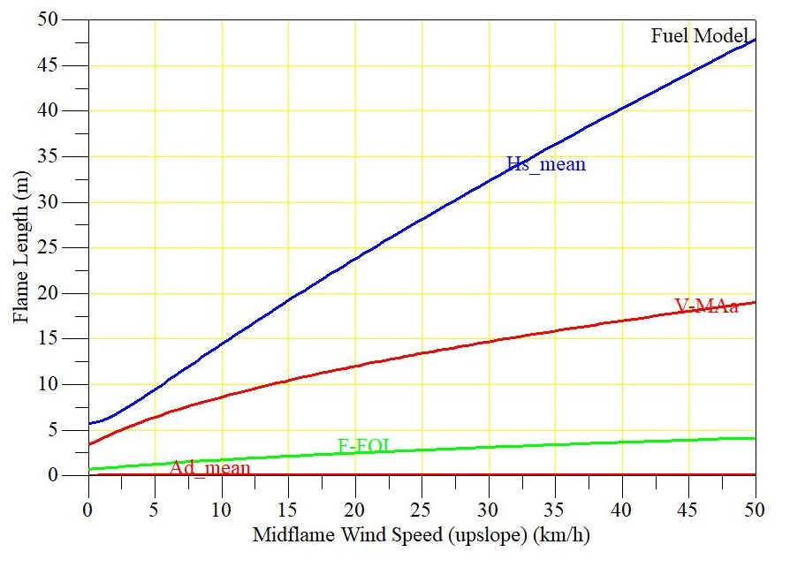
Simulated fire behavior
H. sericea
Tall shrubland
Broadleaf forest
A. dealbata

Slide 22
H. sericea
Tall shrubland
Broadleaf forest
A. dealbata

Slide 23
H. sericea
Tall shrubland
Broadleaf forest
A. dealbata

Slide 24
Preliminary conclusions
Despite the general assumption that alien plants tend to increase the fire hazzard of invaded ecosystems, this may not necessarily hold true
The two species present very diferent fuel characteristics and therefore distinct fire behavior potential
In the case of A. dealbata preliminary results seem to indicate a low fire behavior potential in surface fires, given the highly compacted litter and the absence of other plants in the understorey
On the contrary, H. sericea seems to present a much higher fire hazard than typical mediterranean shrublands

Slide 25
Thank you!

