Slide 1
GMÓVEL
Controlo de infestantes com Galinhas na linha de Vinha, Pomares e entrelinhas das culturas hortícolas e produção de ovos e carne (Weed control with Chickens)
Project duration: December 2016 - November 2021

Slide 2
GOALS
Replace the application of herbicides by grazing chickens to control weeds in vineyard lines, vegetable gardens and orchards.
Improved farm profitability through the incorporation of organic matter and the production of eggs and meat.

Slide 3
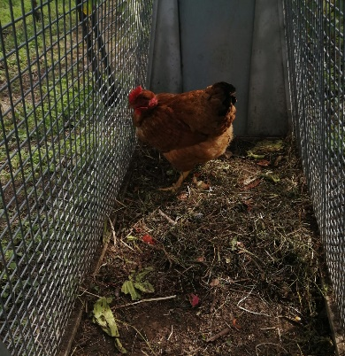
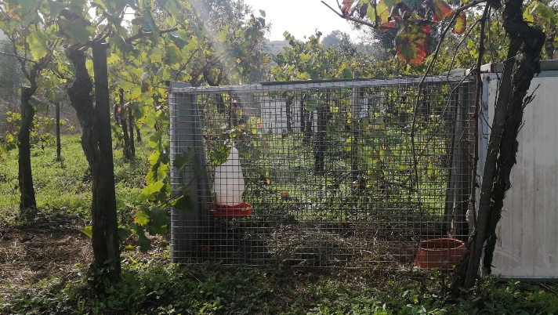
CONTEXT
Weed control is a great difficulty and a high cost for farmers who intend to do Organic Farming.
Indigenous chickens, on pasture confined by structures designed for this purpose, allow weed control and prevent access to the crop.

Slide 4
PARTNERS
Luís Manuel Gonçalves de Sousa
Maria de Fátima Torres
António Sampaio Marques da Cruz

Slide 5
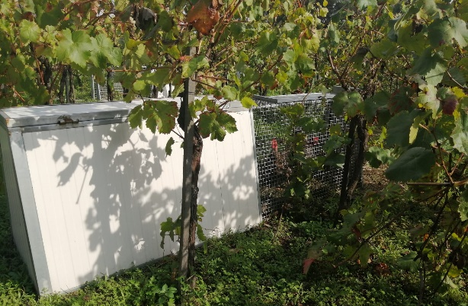
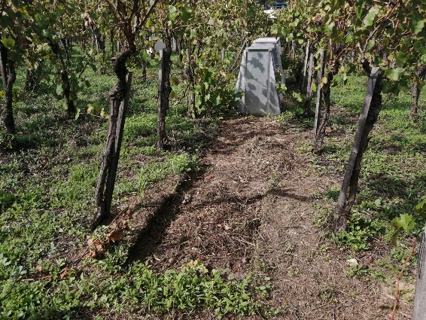
RISKS AND CONSTRAINTS
Weather conditions
Predators
Possibility of escape

Slide 6
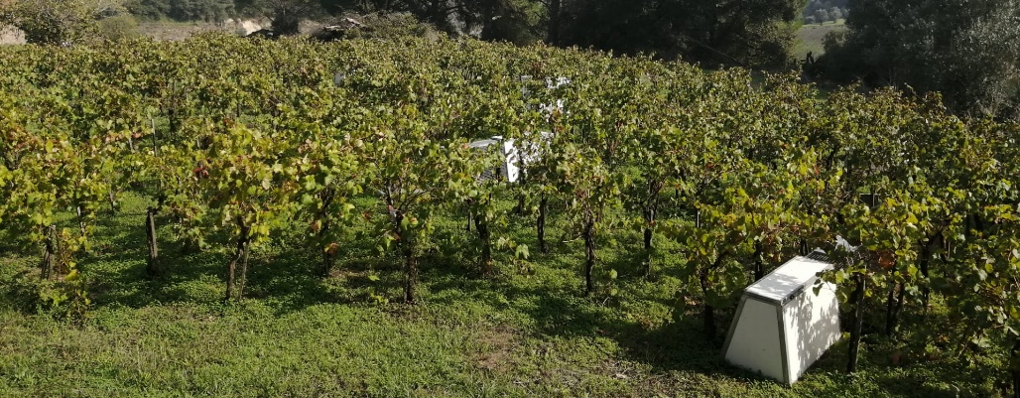
EXPECTED RESULTS
Reduction of obstacles to conversion to Organic Farming.
Creation of a promotional film about the control of weeds using organic chickens.
Incorporation of the method in at least three producers.
Disclosure of the method.

