Slide 1
COELHOS BIO
Produção de Coelhos Biológicos
Project duration: November 2016 - November 2021

Slide 2
CONTEXT
Portugal has great potential for organic rabbit farming.
However, the lack of specific legislation, experience and dissemination of knowledge means that there is currently no production of organic rabbits in Portugal.

Slide 3
GOALS
Create a new product: Organic rabbit national production.
Test and adapt this new production method to the specific conditions of our country.

Slide 4
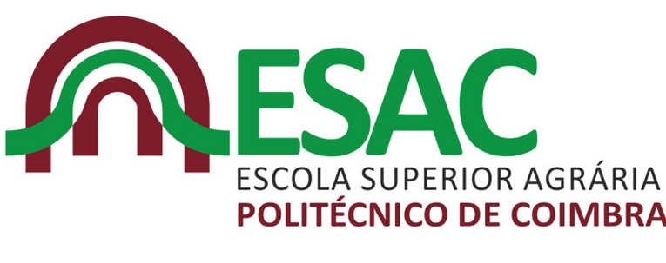
PARTNERS
António Sampaio Marques da Cruz
Luís Manuel Gonçalves de Sousa

Slide 5
EXPECTED RESULTS
Install at least one organic rabbit production farm.
Write a “Manual prático da Produção Biológica de Coelhos em Portugal”.
Disseminate the organic rabbit production method to other rabbit breeders.

